Slide 1
Module: Develop Enterprise Applications Qualification: Professional Diploma in Web Development
Introduction to Spring Boot
By the end of this tutorial you will be able to understand the basics of Spring Boot.

Slide 2
Contents
S. No. | Topic Description | Required / Optional
01 |  | Required
03 |  | Required
04 |  | Required
05 |  | Required
06 |  | Required
07 |  | Required
08 |  | Required
09 |  | Required
10 |  | Required

Slide 3
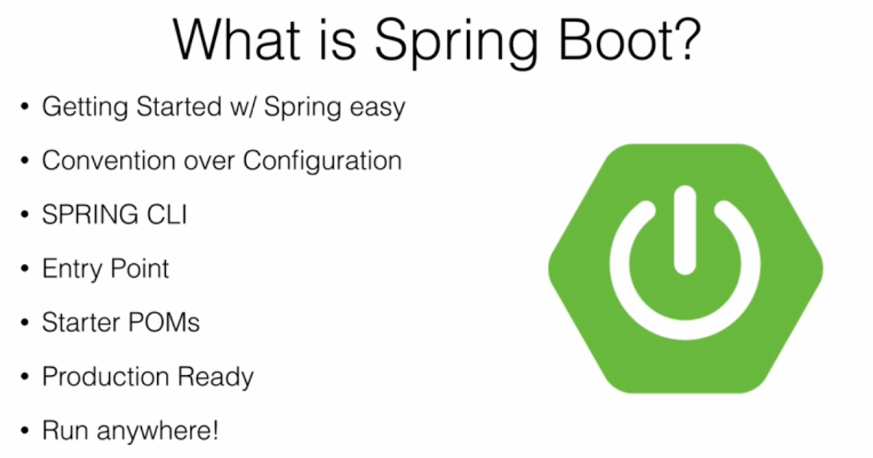
Spring Boot
Spring boot is a Spring framework which provides RAD (Rapid Application Deveolopement) feature to the Spring framework.
It is highly dependent on the starter templates feature which is very powerful and works flawlessly.
It helps you build, package and deploy the Spring application with minimal or absolutely no configurations.

Slide 4
Features of Spring Boot
Create stand-alone runnable jar applications
Embed Tomcat, Jetty or Undertow directly (no need to deploy WAR files)
Designed for containerization and micro-service architecture.
Provide opinionated 'starter' dependencies to simplify your build configuration
Minimal configuration via auto-configuration.
Automatically configure Spring and 3rd party libraries whenever possible
Provide production-ready features such as metrics, health checks and externalized configuration
Absolutely no code generation and no requirement for XML configuration

Slide 5
System Requirements
Spring Boot 2.1.6.RELEASE requires Java 8 and is compatible up to Java 11 (included).
Spring Framework 5.1.8.RELEASE or above is also required.
Explicit build support is provided for the following build tools:
Spring Boot supports the following embedded servlet containers:
Build Tool | Version
Maven | 3.3+
Gradle | 4.4+
Name | Servlet Version
Tomcat 9.0 | 4.0
Jetty 9.4 | 3.1
Undertow 2.0 | 4.0

Slide 6
Installation Instruction
You can use Spring Boot in the same way as any standard Java library.
Include the appropriate spring-boot-*.jar files on your classpath.
Spring Boot does not require any special tools integration, so you can use any IDE or text editor.
You can run and debug a Spring Boot application as you would any other Java program.
You could copy Spring Boot jars
Recommend that you use a build tool that supports dependency management (such as Maven or Gradle).

Slide 7
Notable Highlights
Quick Start:
Spring Boot makes it easy to create stand-alone, production-grade Spring based Applications that you can "just run".
Auto-configuration:
Sets up your application based on the surrounding environment, as well as hints what the developers provide.
Standalone:
It's completely standalone. Hence, you don’t need to deploy your application to a web server or any special environment. Your only task is to click on the button or give out the run command, and it will start.
Opinionated:
This means that the framework chooses how to do things for itself. This is the point where a lot of people says "wait a minute, I do not want to participate in it." Here I encourage you to wait for a second and hold your judgment for now, because, actually, it can be a good thing.

Slide 8
Auto-configuration

Slide 9
Difference Between Spring & Spring Boot
Basis | Spring | Spring Boot
Configuration | To design any spring based application, a developer needs to be taken care on manual set up on Hibernate data source, Entity Manager, Session Factory, Transaction Management everything. | To Design all those common set up, a developer doesn’t need to define everything individually, SpringBootConfiguration annotation enough to manage everything at the time of deployment.
XML | Spring MVC application some of the XML definition mandatory to manage. | Configuring Spring Boot Application nothing needs to be managed, the only annotation managed everything.
Controlling | As configuration can be easily handled by manually, so Spring or Spring MVC can manage to not loading some of the unwanted default features for that specific application. | In case of Spring Boot, it automatically handled on default loading part, so the developer doesn’t have as such concept of not loading some of the specific unusable spring default features.
Use | Better to use if application type or characteristics are purely defined. | Better to use where application type of functionality for future use not properly defined. As integrating any Spring specific feature will be auto-configured in here, so no need any additional configuration.

Slide 10
Spring vs. Spring Boot
Spring Platform
Spring Boot
Light-weight POJO based approach instead of EJBs.
Suitable for Service-Oriented Architecture
Manual Configuration
Need to manage dependencies manually
Dependency versions needs to be compatible.
XML and Annotation based configurations
Runnable Jar and embedded Tomcat based approach.
Suitable for Micro-Service Architecture.
Auto-Configuration
Starter POMs manage dependencies.
Dependency versions are managed automatically.
Purely Annotation based minimal configuration.

Slide 11
Practical Objectives
Create “Hello World” Spring Boot Application
Create Application having REST APIs in Spring Boot which allows end-user to perform following tasks:
Register themselves to our Application Platform.
See the list and details of all users
Update and delete their details.
Generate API Documentation using Swagger.
Our application will mainly have three tables: User, Address and Role.
We will interact with our application using POSTMAN.

Slide 12
Spring Initializr
Spring Initializr provides an extensible API to generate quickstart projects.It also provides a configurable service.
It provides a simple web UI to configure the project to generate and endpoints that you can use via plain HTTP.
Spring Initializr also exposes an endpoint that serves its metadata in a well-known format to allow third-party clients to provide the necessary assistance.
Initializr offers a configuration structure to define all the aspects related to the project to generate: list of dependencies, supported java and boot versions, etc.
Next, we will create a Spring Boot project using Spring Initializr hosted by https://start.spring.io/

Slide 13
Project Setup Steps
Create project from Spring Initializer as shown below slides
Configure your IDE (Spring Tools Suite or Eclipse) for Lombok
Start the IDE and import the starter project created in 1st step.
File -> Import -> Existing Maven Project
Examine the directory structure of project and following files:
pom.xml
application.properties
ApplicationTest.java (it may be AppApplicationTest.java or something else)
Application.java (it may be AppApplication.java or something else)

Slide 14
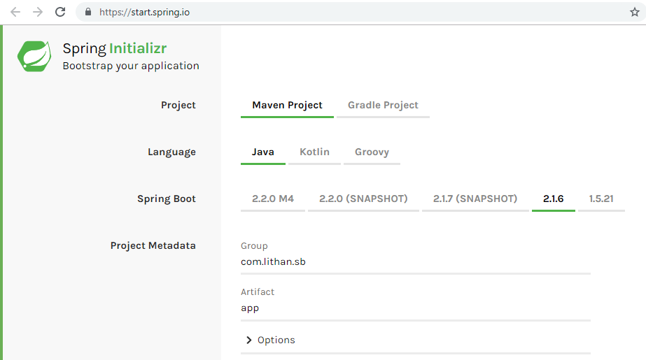
Spring Initializr - Basic Configuration

Slide 15
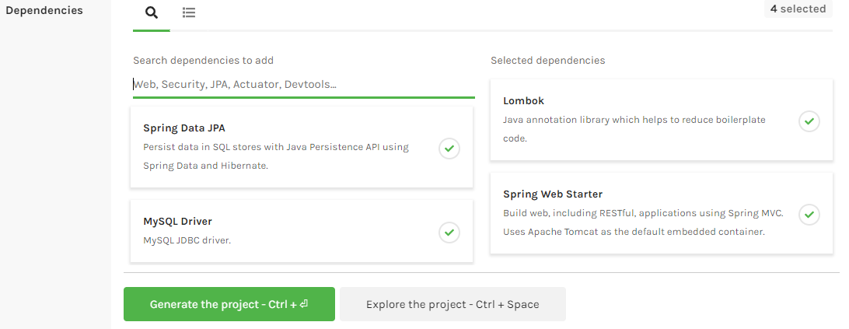
Spring Initializr - Dependency Management
Once you generate the project from Spring Initializr, you will receive the basic project structure in archive format (zip or tar).
You can extract it and import as a maven project.

Slide 16
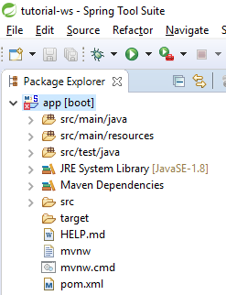
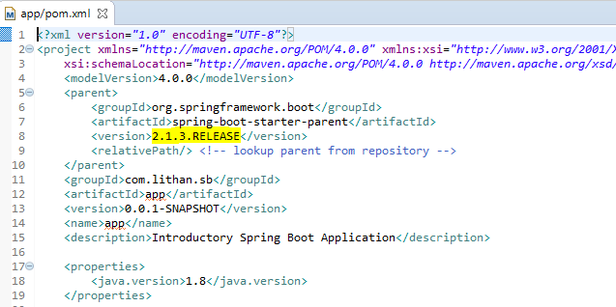
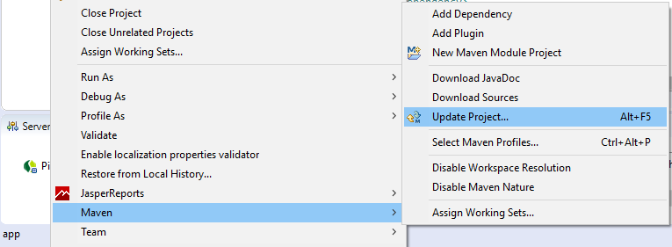
Fixing Version Error - Only if needed!
1
2
3

Slide 17
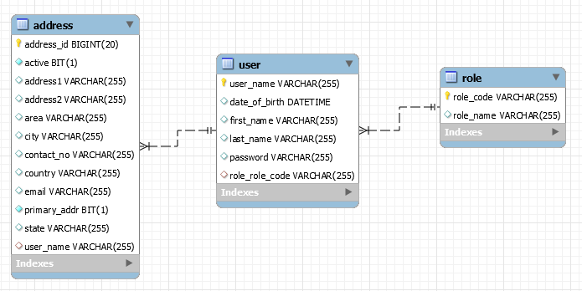
Schema Design

Slide 18
Spring Boot Application
@SpringBootApplication
public class Application {
private static final Log LOG =
LogFactory.getLog(Application.class);
public static void main(String[] args) {
SpringApplication.run(Application.class, args);
String user;
if(args.length>0) {
user = args[0];
}else {
user = "Spring Boot";
}
LOG.info(MessageFormat.format(
"============= Hello {0} world! =============", user));
}
}

Slide 19
Running Spring Boot Application
You need to first build the jar in maven using the command mvn clean install.
Then you can run the jar using command as follow:
java -jar target/app-0.0.1-SNAPSHOT.jar
You can also try passing your name as argument in above command as shown below:
java -jar target/app-0.0.1-SNAPSHOT.jar Daniel
Alternatively, you can run your application directly from IDE as well.
The key feature of Spring Boot Application is it's starter POMs and auto-configuration which enables us to focus on writing business logic with very minimal setup, without worrying about writing any boiler-plate configuration code.
As you will see, getting a Spring Boot application up and running is very quick and smooth, which was not the case with Spring Framework.

Slide 20
@SpringBootApplication
@SpringBootApplication annotation enables the auto-configuration feature and tells JVM the entry point of Spring Boot Application.
This annotation encapsulates the working of three different annotations:
@Configuration: Allows the developers to explicitly register the beans for custom configurations.
@ComponentScan: Enables the component-scanning so that the controller class and other stereotype components will be automatically discovered and registered as beans in spring’s application context.
@EnableAutoConfiguration: Enables the auto-configuration feature of spring boot.

Slide 21
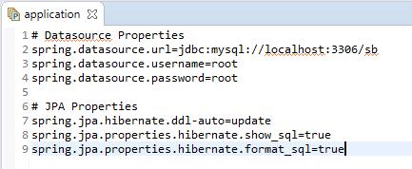
Update application.properties
We need to create a Schema in MySQL and mention it's name in this property file.
For tutorial purposes, we will use the schema name “sb” which stands for Spring-Boot.
Then we need to update application.properties to point to our MySQL instance on localhost.
The JPA properties ensures that Tables in Schema are automatically created/updated in case of changes in our Java Domain Objects.
We are also enabling “show_sql” and “format_sql” property to see Hibernate generated queries in a well formatted manner.

Slide 22
Application Layers
Model - Contains Java Domain Objects
User.java, Address.java and Role.java
Dto - Contains Data Transfer Objects
UserDto.java, AddressDto.java, RegistrationFormDto.java
Projection - Contains Projection Interfaces as alternative to Dtos.
AddressProjection.java
Repository - Jpa Interfaces and Implementations for Persistence Layer
UserRepository.java, AddressRepository.java, RoleRepository.java
Service - Business Logic Implementation and Transaction Management.
UserService.java
Controller - REST Controllers for various API end-points.
UserController.java
Constants - Interfaces containing constant values as best practice.
GlobalConstants.java
Exceptions - This layer defines all the custom exceptions.
UserNameAlreadyInUseException.java, RoleNotFoundException.java, IncorrectDateFormatException.java

Slide 23
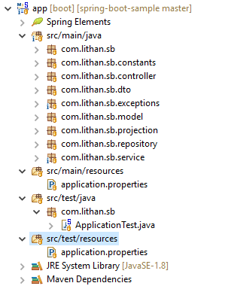
Project Structure

Slide 24
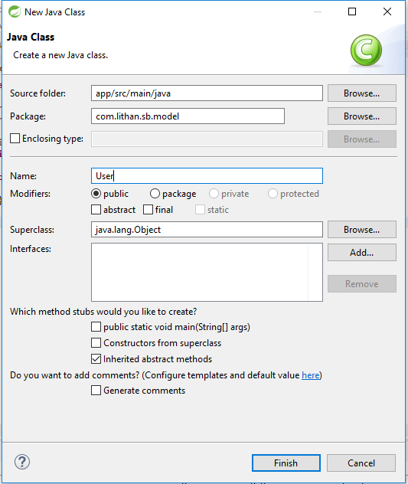
Let's get started!!!
The crux of any Enterprise Application lies in it's Data Design.
We start Data Designing by creating User model.
File -> New -> Class
This model will contain basic details of the user.
User model will also have Associations will Address and Role model.

Slide 25
Model specific annotations
@Entity annotation defines that a class can be mapped to a table.
@Id annotation is inherited from javax.persistence.Id indicating the member field below is the primary key of current entity .
@GenerateValue annotation is to configure how the primary key should be auto-generated and incremented. It has four generation strategies viz. Auto, Identity, Sequence and Table.
@OneToMany mapping means that one row in current table is mapped to multiple rows in referrencing table.
@ManyToOne mapping means that many rows of current table can be associated with a single row of referrencing table.
@JoinColumn specifies a column for joining an entity association or element collection. If the JoinColumn annotation itself is defaulted, a single join column is assumed and the default values apply.

Slide 26
Role.java
package com.lithan.sb.model;
import javax.persistence.Entity;
import javax.persistence.Id;
import lombok.Data;
@Data
@Entity
public class Role {
@Id
private String roleCode;
private String roleName;
}

Slide 27
User.java
@Data
@Entity
public class User {
@Id
private String userName;
private String firstName;
private String lastName;
private Date dateOfBirth;
@OneToMany(cascade = CascadeType.ALL,
mappedBy = "user", fetch = FetchType.EAGER)
private List<Address> addressList = new ArrayList<>();
@ManyToOne(fetch = FetchType.EAGER)
private Role role;
}

Slide 28
Address.java
@Data
@Entity
public class Address {
@Id
@GeneratedValue(strategy = GenerationType.IDENTITY)
private long addressId;
@ManyToOne(cascade = CascadeType.ALL)
@JoinColumn(name = "userName")
private User user;
private String address1, address2, area, city, state, country;
private String contactNo;
private String email;
private boolean active;
private boolean primaryAddr;
}

Slide 29
Dtos and Projections

Slide 30
RegistrationFormDto & AddressProjection
@Data
public class RegistrationFormDto {
private String userName;
private String firstName;
private String lastName;
private String dateOfBirth;
private long addressId;
private String address1, address2,
private String area, city;
private String state, country;
private String contactNo;
private String email;
private boolean active;
private boolean primaryAddr;
private String roleCode;
}
public interface AddressProjection {
public long getAddressId();
public String getUserFirstName();
public String getUserLastName();
public String getUserUserName();
public String getAddress1();
public String getCity();
public String getState();
public String getCountry();
public String getEmail();
public boolean getActive();
}

Slide 31
Exceptions
Custom Exception Handling Mechanism through RuntimeException extended classes

Slide 32
Custom Exceptions
We want to cover 3 scenarios where we would like to throw custom exceptions:
The entered User Role is not available in our Role table.
Username is already picked by another user, hence not available.
Date format of a given field is not as expected.
RuntimeException is the superclass of those exceptions that can be thrown during the normal operation of the Java Virtual Machine.
RuntimeException and its subclasses are unchecked exceptions which does not need to be declared in throws clause of a method or a constructor.
We will create custom exception classes as follows, which will extend RuntimeException:
RoleNotFoundException.java
UserNameAlreadyInUseException.java
IncorrectDateFormatException.java

Slide 33
Custom Exceptions - 2
Custom Exceptions are mainly specific to business logic and workflow. We can use them as part of validation or to perform certain logic on their occurance.
These customs exceptions also helps end-user to understand the error in terms of meaningful business language, which is not the case with Java or Spring specific exceptions.
In order to create custom exception, we have to follow 4 steps:
Create an exception class and extend it with RuntimeException
Add business logic specific variables in the class like a particular ID or information, which we want to expect from the caller.
Override the getMessage() method and create a parameterized constructor for customization of error message.
Throw the Custom Exception from the Handler Class.

Slide 34
RoleNotFoundException.java
public class RoleNotFoundException extends RuntimeException{
private String roleCode;
public RoleNotFoundException(String roleCode) {
this.roleCode = roleCode;
}
@Override
public String getMessage() {
StringBuilder sb = new StringBuilder();
sb.append("Role Code: '");
sb.append(this.roleCode);
sb.append("' ");
sb.append("not an acceptable value. ");
sb.append("Acceptable values are: 'Admin', 'User' and 'Moderator'");
return sb.toString();
}
}

Slide 35
Repositories
Persistence Layer

Slide 36
Repositories
Repository is the layer in Web Applications which takes care of talking with Database in order to either retrieve data, or write back the date.
We can create Repositories in Spring Boot by extending our Custom Interface with JPA interfaces called JpaRepository or CrudRepository.
Our custom interfaces comes with out-of-the-box methods to perform CRUD operations, as well as we can create methods in them without defining them. This can be done by following JPA nomenclature to define repository methods.
If we want to write native SQL and custom implementation of Repository methods, we need to use Spring @Repository annotation which provides the mechanism for storage, retrieval, search, update and delete operation on objects.
In our example, we will just focus on JpaRepository based interface.

Slide 37
UserRepository.java
public interface UserRepository extends JpaRepository<User, String>{
<T>T findDtoedByUserName(String userName, Class<T> dto);
<T>T findAllDtoedByRoleRoleCode(String roleCode, Class<T> dto);
}
AddressRepository.java
public interface AddressRepository extends JpaRepository<Address, Long>{
<T>List<T> findDtoedByUserUserName(String userName, Class<T> projection);
<T>List<T> findProjectedByUserUserName(String userName, Class<T> projection);
}

Slide 38
Service
Business Logic Layer

Slide 39
Service Layer
This layer is the crux of our Spring Boot Application and it will the Service classes and service methods holding all the business logic related to our application.
We use the stereotype annotation @Service to denote a class to be a service class.
Service layer receives method call from Controller layer and processes the service request. A single service request ideally would correspond to a single functionality of real-world business requirement.
A single service layer method may call one or more repository methods in order to perform a single function. Transaction management will be taken care by this layer using @Transactional annotation.
We would ideally want to either commit or roll-back all the repository operations done in a single service method i.e. single functional method.

Slide 40
UserService.java
@Service
@Transactional(readOnly = true, rollbackFor = Exception.class)
public class UserService {
@Autowired
UserRepository userRepository;
@Autowired
RoleRepository roleRepository;
@Autowired
AddressRepository addressRepository;
private static final SimpleDateFormat sdf = new SimpleDateFormat(GlobalConstants.DD_MM_YYYY);
public User registerUser(RegistrationFormDto registrationFormDto) throws RoleNotFoundException{
//
// Business Logic code goes here
//
}

Slide 41
Rest Controller
API Layer

Slide 42
Rest Controller
@Controller annotation indicates that the annotated class is a controller. It is a stereotype annotation which is a specialization of @Component and is autodetected through classpath scanning.
It is typically used in combination with annotated handler methods based on the @RequestMapping annotation.
@RestController is a sibling convenience annotation for creating Restful controllers.
Combination of @Controller and ResponseBody is equivalent to using the annotation @RestController.
When interacting with our web application, we will make HttpRequest which will eventually be landed on various Rest Controllers and method end-points inside them created by us.
Our HttpRequests will be in Json format as part of REST Protocal and so will be HttpResponses.

Slide 43
UserController.java
@RestController
@RequestMapping(value = "/user")
public class UserController {
@Autowired
UserService registrationService;
@PostMapping("/save")
public String registerUser(@RequestBody RegistrationFormDto registrationFormDto) {
try{
User user = registrationService.registerUser(registrationFormDto);
return "User registered successfully with userName:
"+user.getUserName();
}catch(Exception ex) {
return ex.getMessage();
}
}
}

Slide 44

THANK YOU

